Slide 1
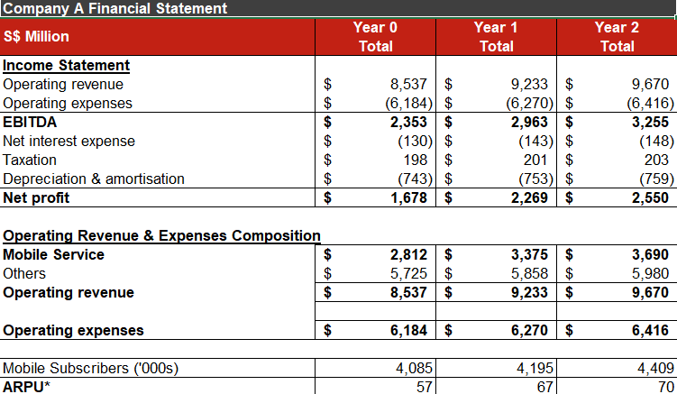
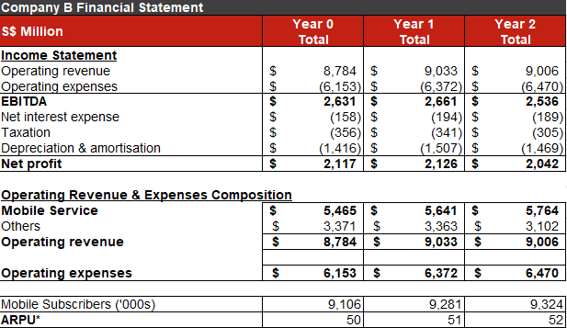
Company A launched it's first mobile handset leasing plans at the start of Year 1.
It aims to make premium handsets more affordable to customers
Company B operates in the same market as Company A, and has not launched leasing plans

Slide 2
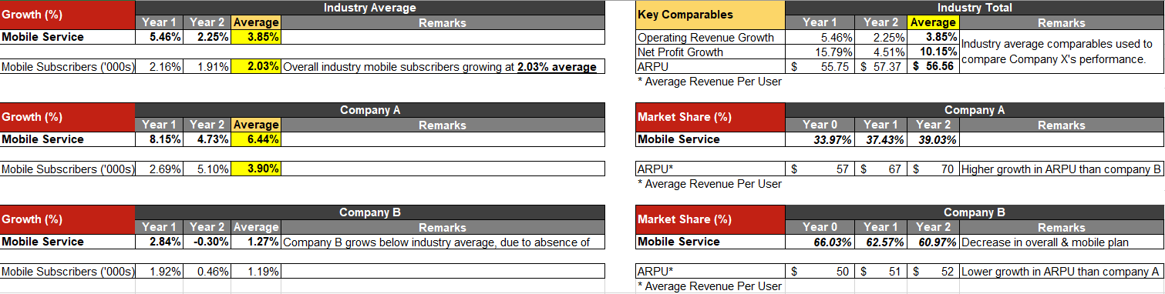

Slide 3
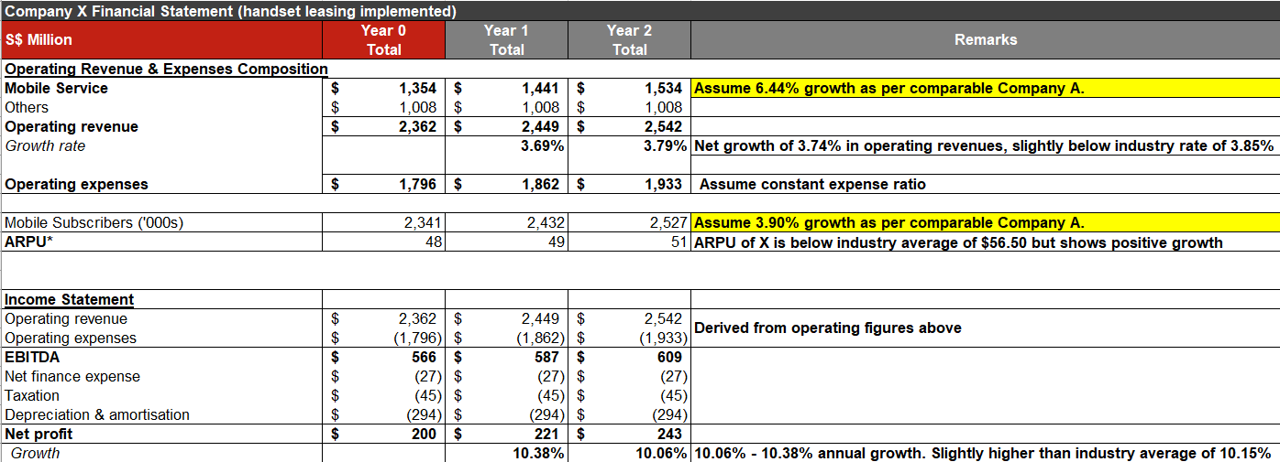

Slide 4
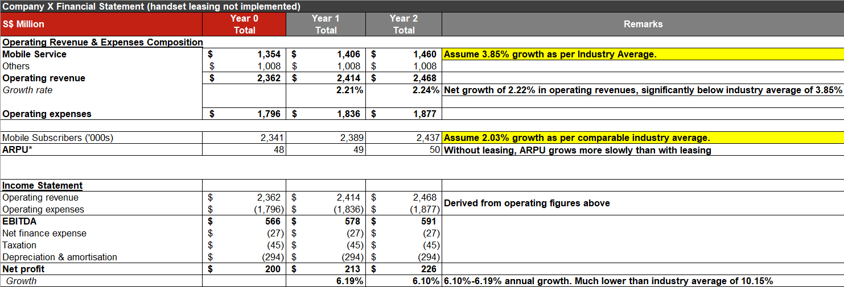
Company X has not launched leasing mobile plans
Forecast the impact of leasing handsets, on the relevant financial statement

Slide 5
